Slide 1

Predicting student performance: an application of Machine learning
By Minh H. Le (2020)

Slide 2
TOPIC Overview
Background
Problems
Description of Datasets
Exploratory Analysis
Machine Learning
Conclusion

Slide 3
Background
Education is the passport to the future. My goal is to help educational institutions, and parents to improve the student academic performance. Based on my analysis, schools and parents will know which factors and reasons affect the student academic performance. With that knowledge, they can help the students to prepare for the future.

Slide 4
Problems
Find out which features (attributes), including student grades, demographic, social and school related features, have effect on high school student performance.
Predicting the student performance.

Slide 5
Description of Datasets
Two datasets:
Mathematics (Excel file) - 395 observations (students)
Portuguese (Excel file) - 649 observations (students)
Total 32 features in both datasets.
Most of the features are categorical (nominal and ordinal) data.
Numerical features:
Absences (number of school absences),
G1 (first period grade)
G2 (second period grade)
G3 (final grade, also the output target)

Slide 6
Description of Datasets (Data Wrangling)
No missing value in both datasets.
For numerical features, there are outliers in both datasets. However, based on information from the dataset description, since none of the outliers are due to incorrectly entered or measuring data, the outliers are kept in the datasets.

Slide 7
Exploratory Analysis

Slide 8

Question 1:
What is the main reason why students choose their current school?

Slide 9
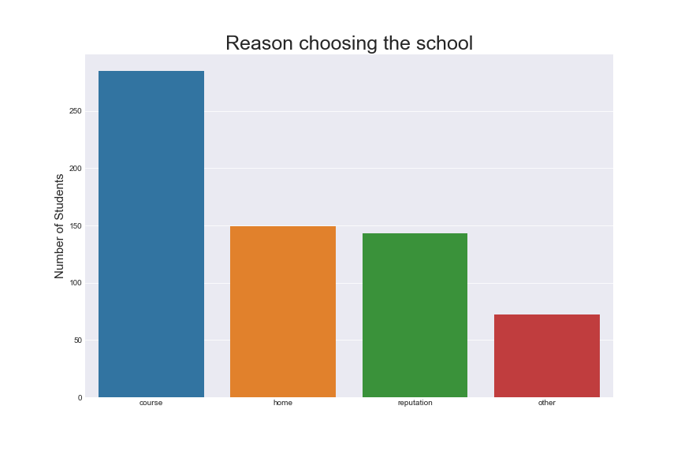
Most of the students choose their school is because of the course preference that the school offers.

Slide 10
Question 2:
There is this stereotype that boys are better than girls at S.T.E.M. (Science, technology, engineering, and mathematics), and girls are better than boys at humanity. Is this true?

Slide 11
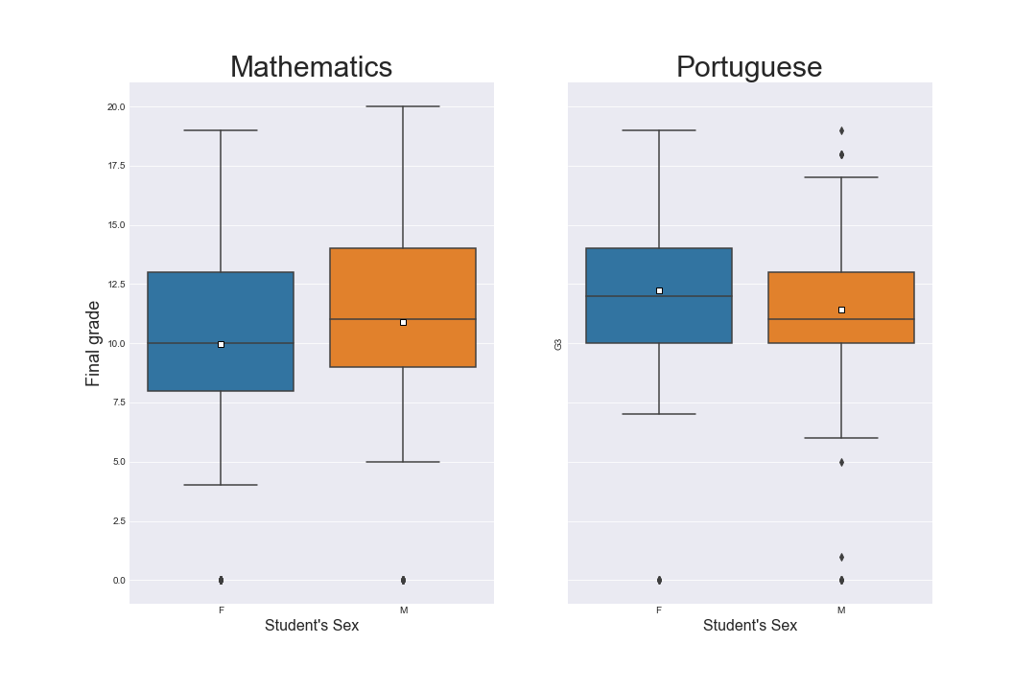
Based on both data sets, the average and median mathematics final grades of male students are higher than those of female students.
In contrast, the average and median Portuguese final grades of female students are higher than those of male students.

Slide 12
Question 3:
Do students who want to take higher education have better grades than those who do not?

Slide 13
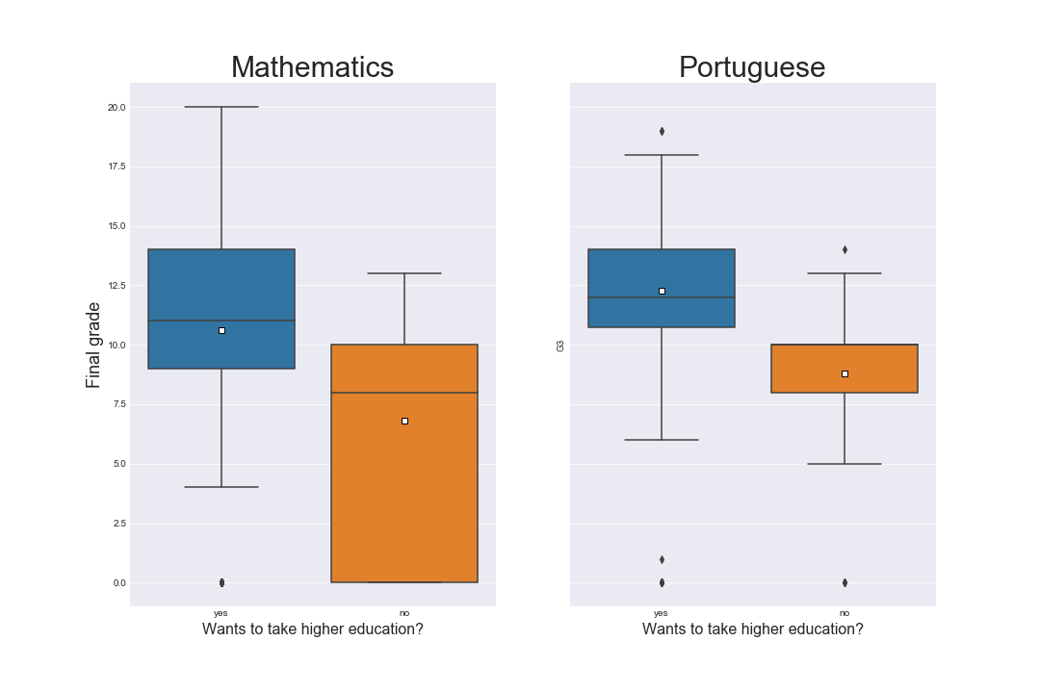
The average and median final grades in both mathematics and Portuguese of students who want higher education are higher than those of students who do not want a higher education.
This seems to be right. Students who want to go to colleges or universities will need good grades to be accepted; therefore, they will have higher grades than those who don't want to.

Slide 14
Question 4:
Do students who have extra educational support have better grade than those who do not?

Slide 15
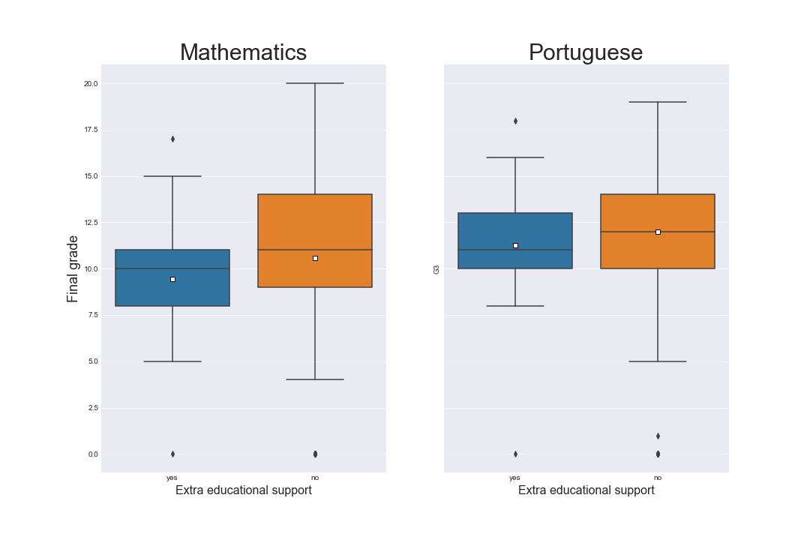
The average and median final grades in both maths and Portuguese of students who have extra educational support are lower than those who do not have.
The reason can be because students who are struggling with the subject will need extra support than those who don't. Therefore, their grades will lower than those who are already good at the subject.

Slide 16
Question 5:
Does going out with friends affect final grades?

Slide 17
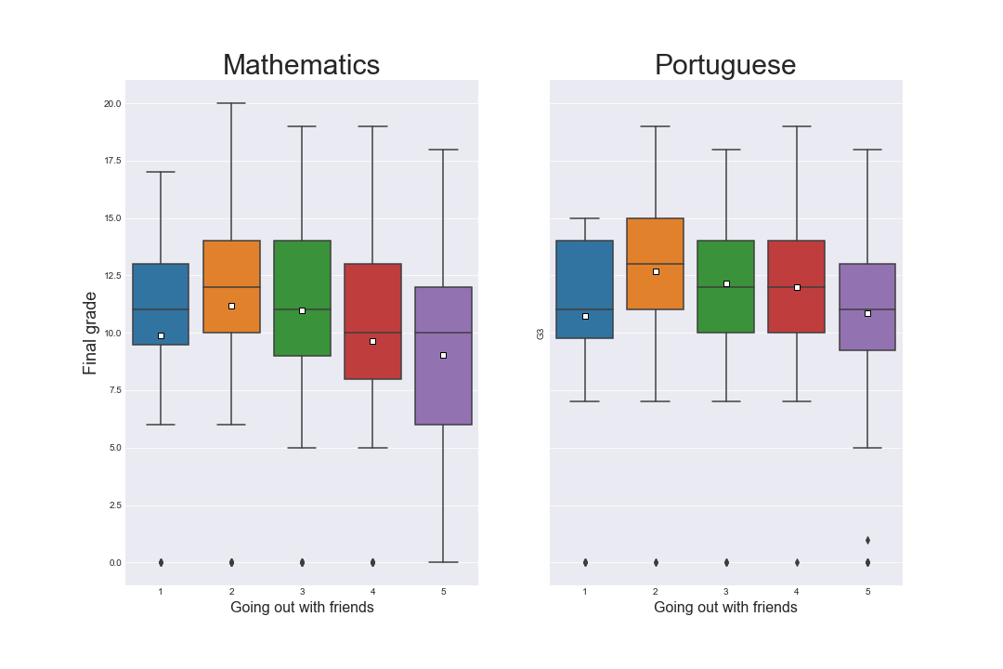
Surprisingly, people who don't go out with friends much (1) and people who are always going out with friends(5) have the lowest average and median final grades in both maths and Portuguese.
People who casually go out with friends (2) have the highest average and median final grades in both courses.

Slide 18
Question 6:
Normally, people believe that study time is a good indicator of student performance. Students who spend more time studying will have better grades than those who don't. Is this true?

Slide 19
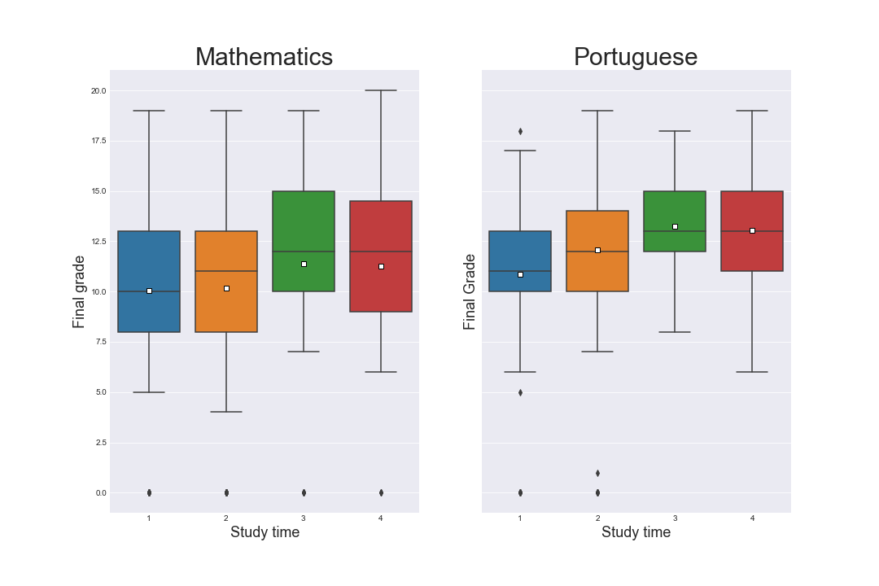
On average, students who spend 5 to 10 hours and more than 10 hours studying have higher grades than those who spend less.

Slide 20
Question 7:
Normally, people believe that student health is a good indicator of student performance. Students who have good health will perform than those who don't. Is this true?

Slide 21
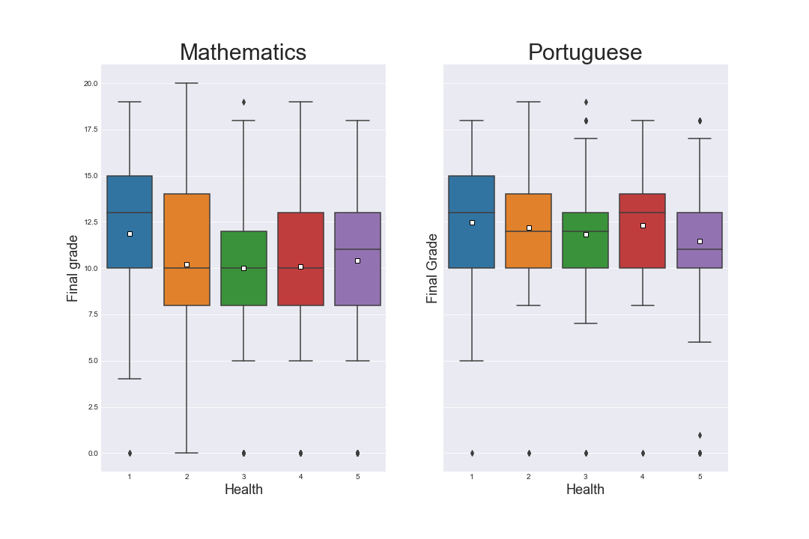
It seems to be false. Students who are the least healthy have the highest average and median final grades in both subjects.
This can be because healthy students are more likely to do more extracurricular activities than those who are not healthy. Therefore, they will spend less time studying, which can affect their final grades.

Slide 22
Question 8:
Is there any correlation between the student's absence and the final grade?

Slide 23
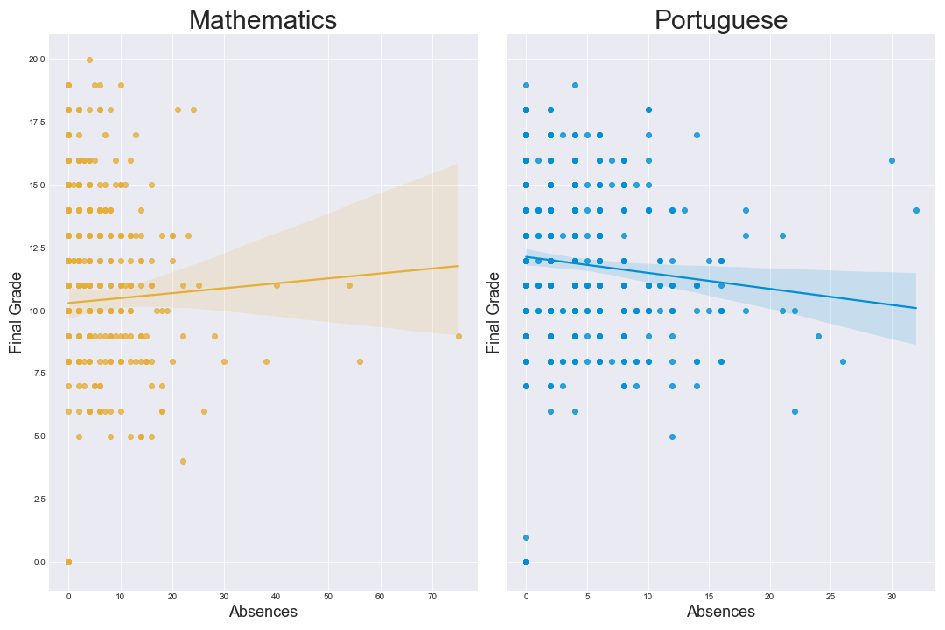
Normally, people believe that student attendance (or absence) is a good indicator of student performance.
However, based on both data sets (Mathematics and Portuguese), there seems to be no correlation between students' absence and final grade.

Slide 24
Question 9:
Is there any correlation between student’s midterm grade and final grade?

Slide 25
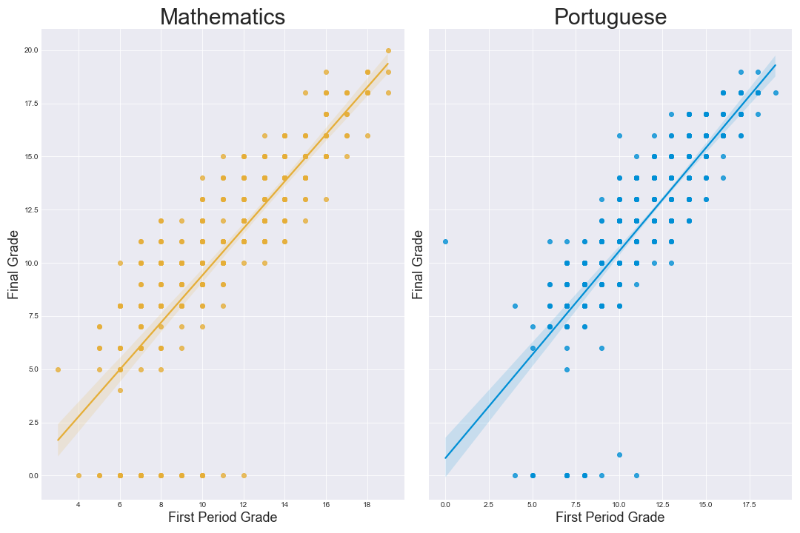
There is a positive linear correlation between first-period grade and final grade.

Slide 26
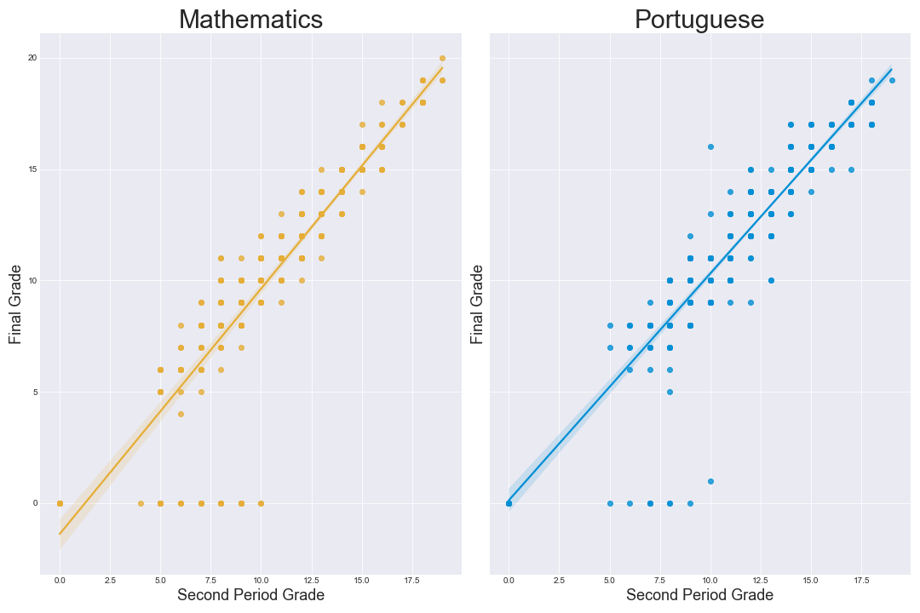
There is a positive linear correlation between second-period grade and final grade.

Slide 27

Machine learning

Slide 28
Machine learning models
Linear regression
Ridge regression
Lasso regression
Support vector machine based regression
Decision trees regression
Random forest regression
Gradient boosting
XGBoost
Light gradient boosted machine (LightGBM)

Slide 29
Evaluation metrics
Coefficient of Determination or R²
Mean Squared Error

Slide 30
Model selection
Choosing the top 3-4 models that has the lowest average of MSE value and the highest average of R² value

Slide 31
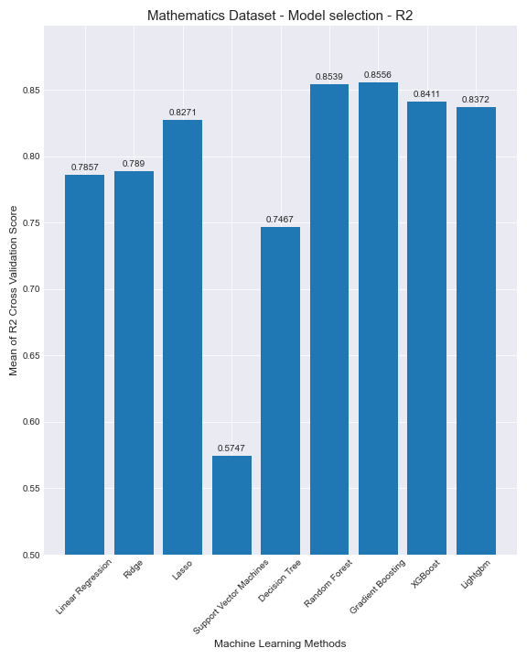
Mathematics dataset - R²
Random forest, gradient boosting and XGBoost have the top highest averages of R² cross-validation score.
Support vector machine has the lowest average of R² cross-validation score.

Slide 32
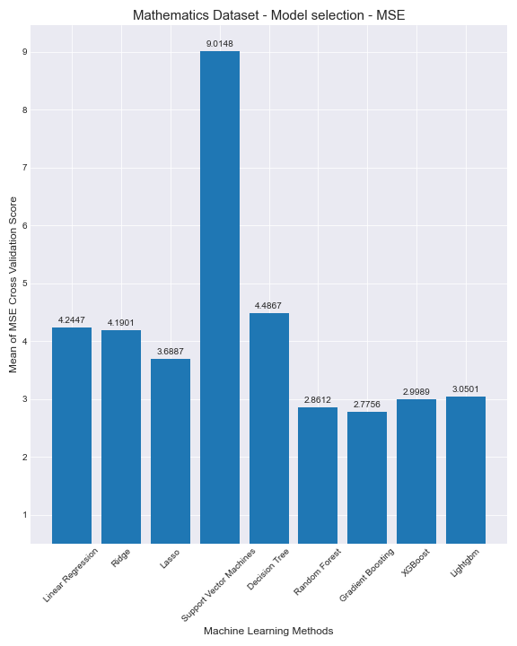
Mathematics dataset - MSE
Random forest, gradient boosting and XGBoost also have the top lowest averages of MSE cross-validation score.
Support vector machine has also the highest average of MSE cross validation-score.

Slide 33
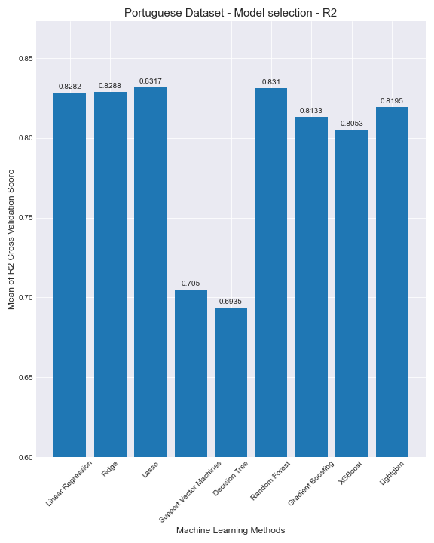
Portuguese dataset - R²
Linear regression, Ridge, Lasso and random forest regression have the top highest averages of R² cross-validation score.
Decision trees and support vector machines regression have the top lowest averages of R² cross-validation score.

Slide 34
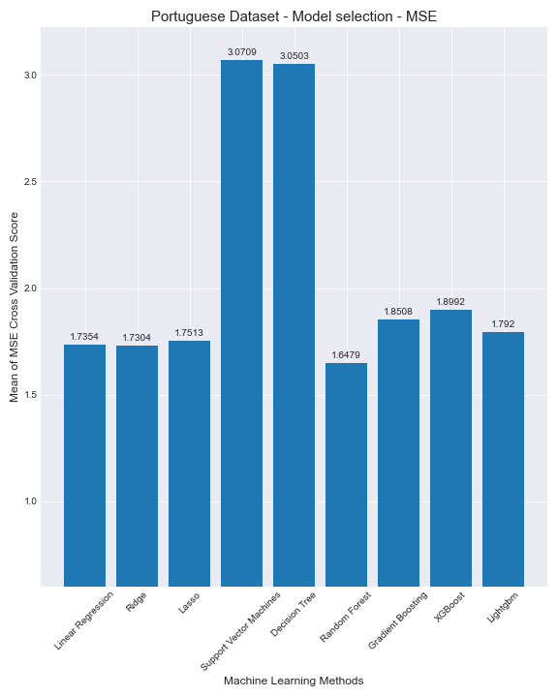
Portuguese dataset - MSE
Linear regression, Ridge, Lasso, and random forest regression have the lowest averages of MSE cross-validation score.
Decision trees and support vector machines regression have the highest averages of MSE cross-validation score.

Slide 35
Model selection
For mathematics dataset, Random forest, gradient boosting and XGBoost have the best performances.
For Portuguese dataset, Linear regression, Ridge, Lasso and random forest regression have the best performances.

Slide 36
Hyperparameter optimization

Slide 37
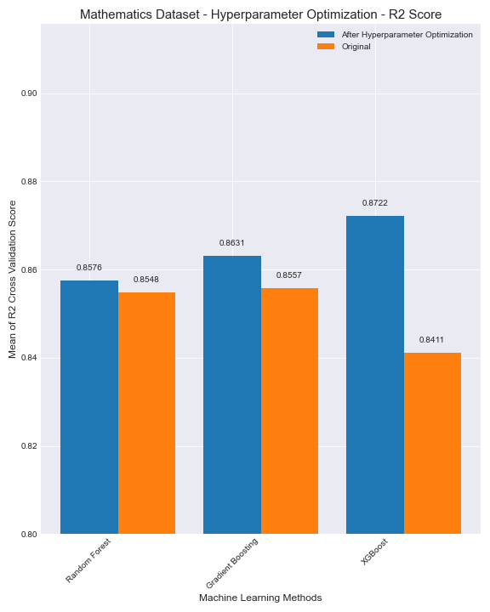
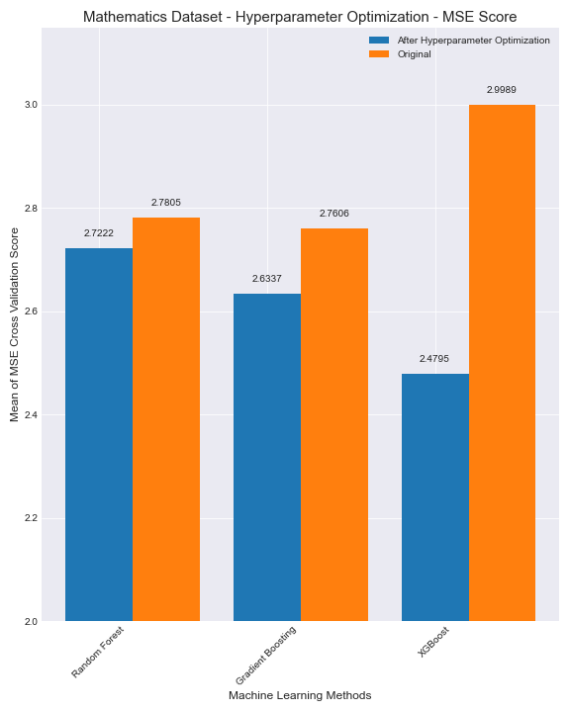
Mathematics dataset
XGBoost regression model performs the best.
It has the highest average of R² cross validation score and lowest average of MSE cross validation score.
It has the most improvement after hyperparameter tuning

Slide 38
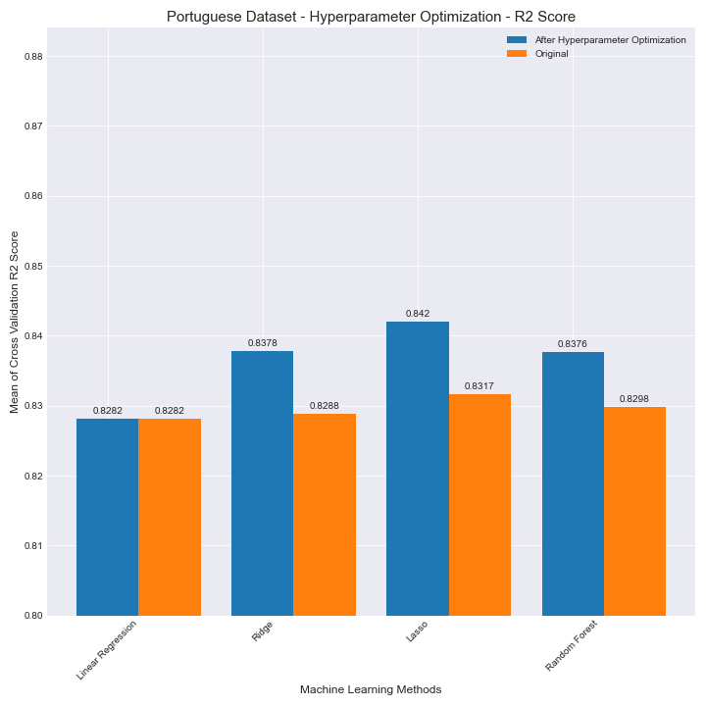
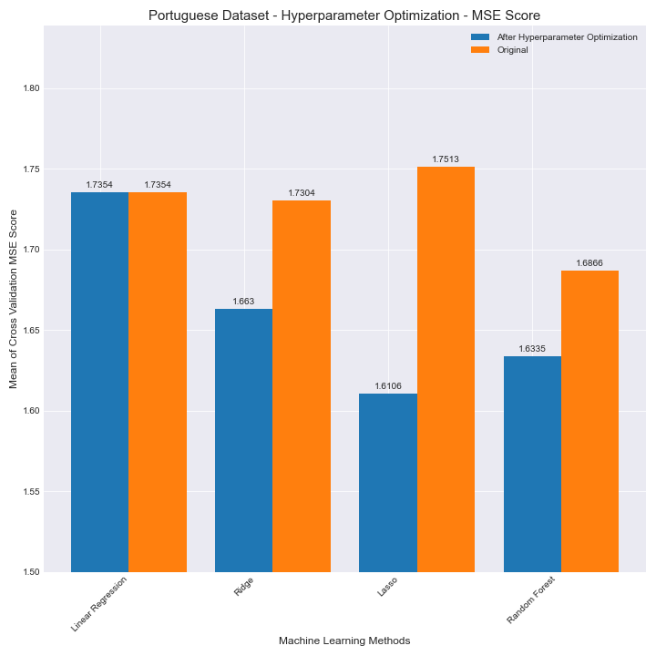
Portuguese dataset
Lasso regression model performs the best.
It has the highest average of R² cross validation score and lowest average of MSE cross validation score.

Slide 39
Important features

Slide 40
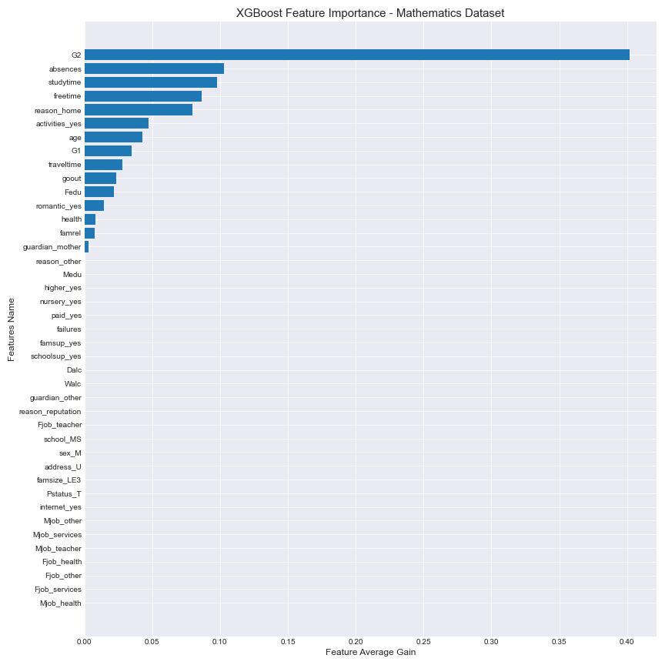
Mathematics dataset
For XGBoost model, gain is used to determine the importance of feature.
Gain implies the relative contribution of the corresponding feature to the model calculated by taking each feature’s contribution for each tree in the model. A higher value of this metric when compared to another feature implies it is more important for generating a prediction.
Second term grade (G2) is the most important feature, following by absences, study time.

Slide 41
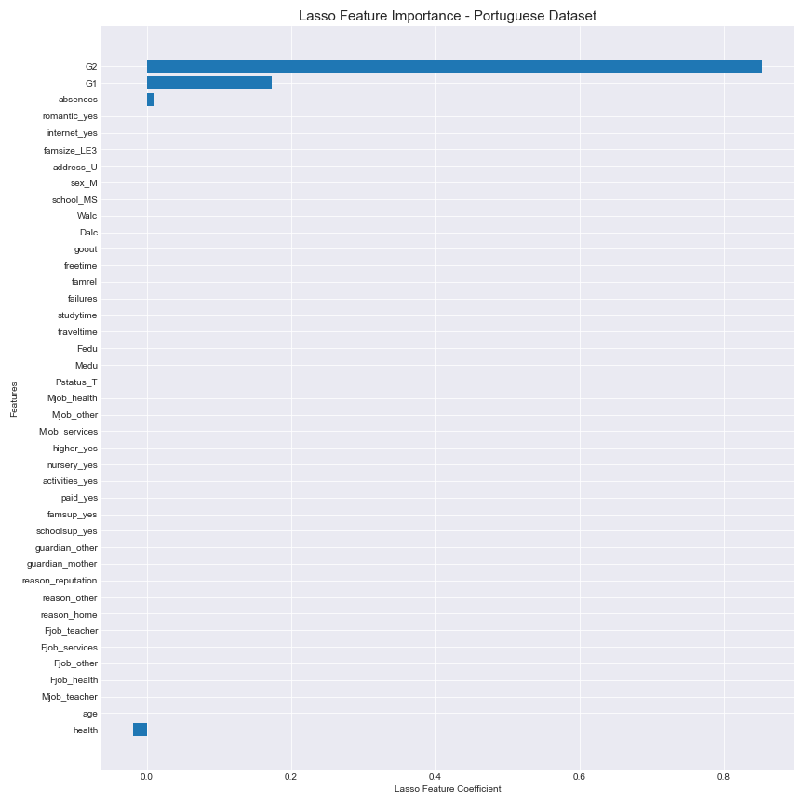
Portuguese dataset
Most of the features do not have correlation with the final grade.
Second term grade has the highest coefficient (0.85399). In other words, if the second term grade increase by 1 point, the average final grade will increase by 0.85399 point.
Second term grade (G2) is the most important feature.

Slide 42
Performance on Test data

Slide 43
Performance on test data
For the mathematics dataset, using XGBoost model:
R2 score is 0.8885
MSE is 2.2619
For the Portugueses dataset, using Lasso regression model:
R2 score is 0.8677
MSE is 1.6405

Slide 44
Conclusion

Slide 45
XBBoost is the best model for mathematics dataset
Lasso regression is the best model for Portuguese dataset.
For both datasets, second term grade (G2) is the most important feature.

Slide 46
Midterm grade and final grade have a strong correlation, so it is not surprising that midterm grade is the most important feature to predict student performance.
Beside midterm grade, other features seem to be irrelevant.
Through this project, one thing we can learn from is that instead of having one final test that determines student performance, having multiple mid-term is also a good predictor of student performance. Having multiple small exams throughout the year helps students to decrease stress and anxiety.

